Slide 1

Bite Sized Umpiring
Dangerous and Unfair Bowling
(or Bouncers and Beamers to you and me!)
Beamers
Slides will build up for you
To move to next slide click your space bar
To start videos click on the image.

Slide 2
This series of short clips and slides aims to:
Jog a few memories for established umpires
To give a few tips to the less experienced
Maybe give players, and especially captains, a few ideas about what they should be looking for when they come to mark an umpire’s performance as many are asked to do on a weekly basis
Provide some food for thought and hopefully some light relief for the viewer
Press your space bar for the next slide

Slide 3
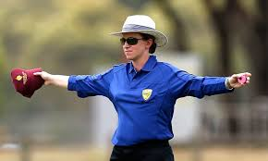
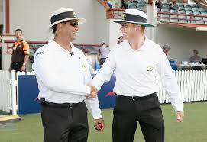
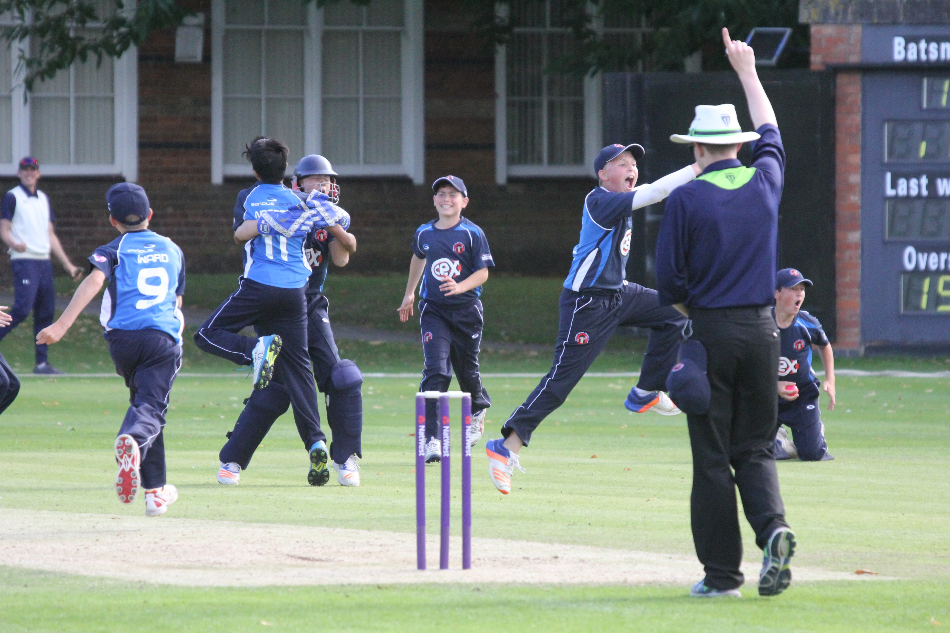
These presentations are an overview only
They will provide you with an understanding of some cricket umpiring techniques, but you will need to develop these skills through practical experience and more structured training should you wish
It won’t teach you everything you need to know, but it will give you some of the tools to start off
Press your space bar for the next slide

Slide 4
Rule No:1 for Beamers (and Bouncers):
The point of reference for judging height is always that of the striker standing upright at the popping crease
This does not change even if the striker comes charging down the pitch
In which case, as Bowler’s end umpire, you are likely to need some assistance from your colleague at Striker’s end in judging the height
Press your space bar for the next slide

Slide 5
Rule No:2
Bowler’s end umpire calls and signals any related No ball
They can look for assistance/confirmation from their colleague
Talk before the game and arrange how you will signal this (We will see some examples later)
It does not matter if the call is a bit delayed
Press your space bar for the next slide

Slide 6
Beamers
Non pitching deliveries above waist height are unfair and should always be called No ball
The umpire has three factors to consider:
Would the ball have passed the striker above waist height when standing upright in the crease whether or not the striker hits it?
Was it dangerous?
Was it deliberate?
Press your space bar for the next slide

Slide 7
Beamers
1. “Would the ball have passed the striker above waist height when standing upright in the crease whether or not the striker hits it?”
Where is “waist height”?
In the Appendix to the Laws (yes, you do need to read this on occasions!) this is defined as “..the point at which the top of the batsman’s trousers would conventionally be when he/she is standing upright at the popping crease”
“Conventionally”???
Press your space bar for the next slide

Slide 8

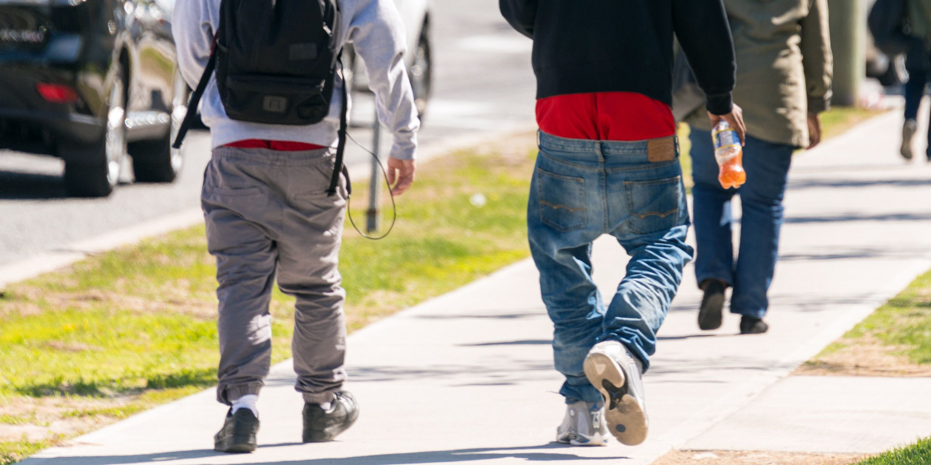
Not sure who’s “convention” we are talking about but you get the picture!
Press your space bar for the next slide

Slide 9
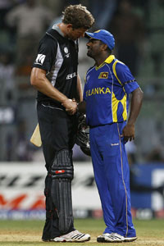
Even when worn “conventionally” there can be quite a difference in the height the delivery can be at!
Bonus points for naming the players?
Click reveal for the answer
Reveal
Jacob Oram (6’6”/1.98m)/Mutiah Muralitharan (5’7”/1.7m)
As already stated the Bowler’s end umpire will appreciate some help from his colleague with the height of these deliveries
Press your space bar for the next slide

Slide 10
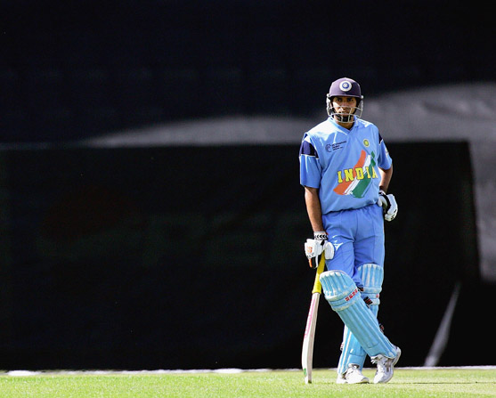
Tip for striker’s end:
It may be possible to pick something in the background at the striker’s waist height as a marker from your position square of the pitch.
In this case the top of the advertising hoarding but it could be a wall or fence
Even if the striker moves the
marker stays in place…..
Press your space bar for the next slide

Slide 11
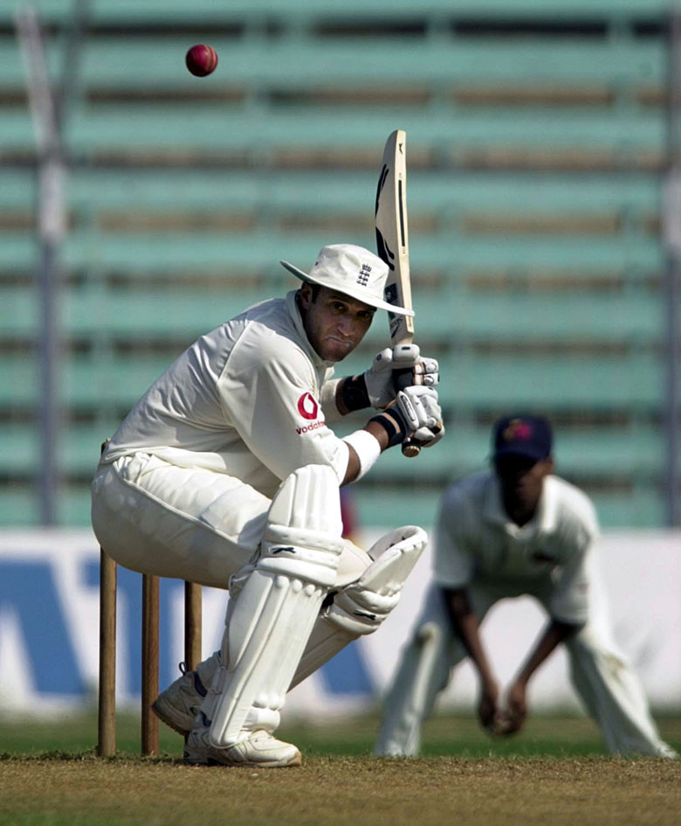
…so although the striker has ducked, or may have come down the pitch you still have a reference point to say if it was over waist high or not as it passed the popping crease.
If the striker hits the ball before it reaches the popping crease then it is obviously a judgement call – was it dropping or flat?
Press your space bar for the next slide

Slide 12
Beamers
2. Was it dangerous?
As with bouncers, this is for the umpires to decide*
The same list of factors applies – speed, height, direction, skill of striker
Again disregard any protective equipment
But adds in REPETITION – why?
(* Unless competition regulations dictate otherwise – see later)
Press your space bar for the next slide

Slide 13
Beamers
Why REPETITION?
  First beamer is 3 yards wide Off Side – not dangerous?
  Second beamer is 3 yards wide Leg Side – not dangerous?
  Where is the third one going?
  Does the bowler have any control?
  Would it be a good idea to give the bowler a first and final warning now to let them know you are concerned for the safety at the striker?
Press your space bar for the next slide

Slide 14
Beamers
The most frequently asked question on Beamers is
“What is dangerous?”
The simple answer is “You will know it when you see it”
Watch the following video clips and see what your reactions are
Ignore the actions of the umpires as these clips are from before the Law was changed to place the onus on the umpires to decide on dangerous or not
Press your space bar for the next slide

Slide 15
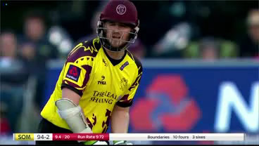
Click on the video to play it
Then press the space bar when video has finished to step on to the next one
Do that for each of the following videos

Slide 16
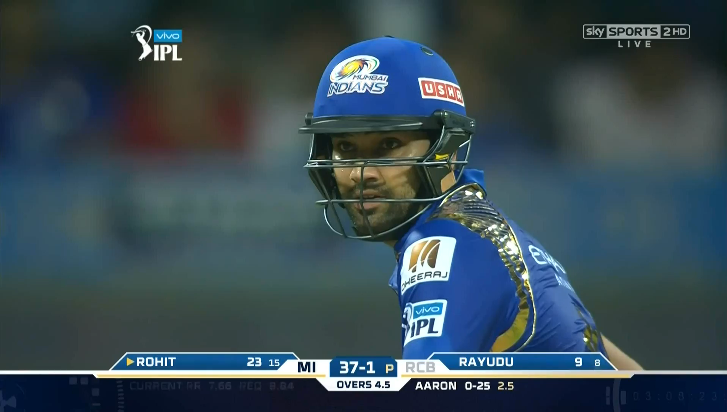

Slide 17
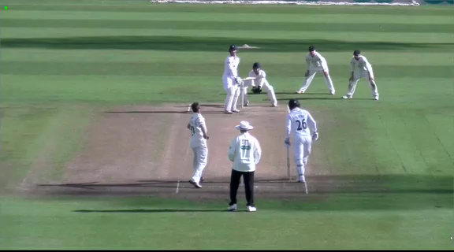

Slide 18
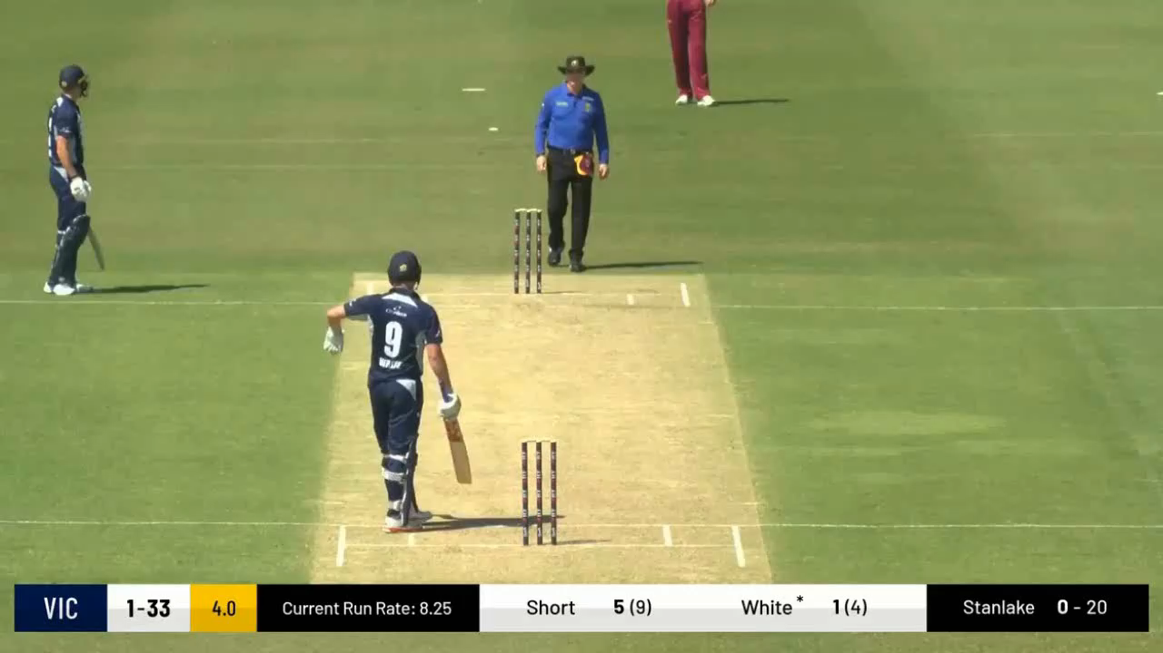

Slide 19
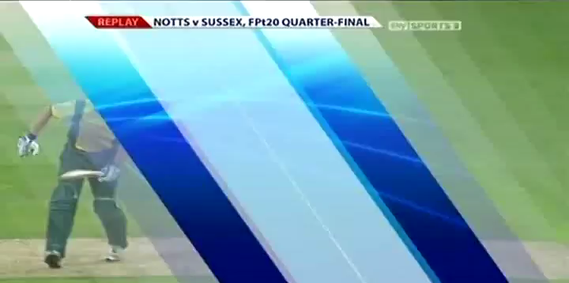

Slide 20
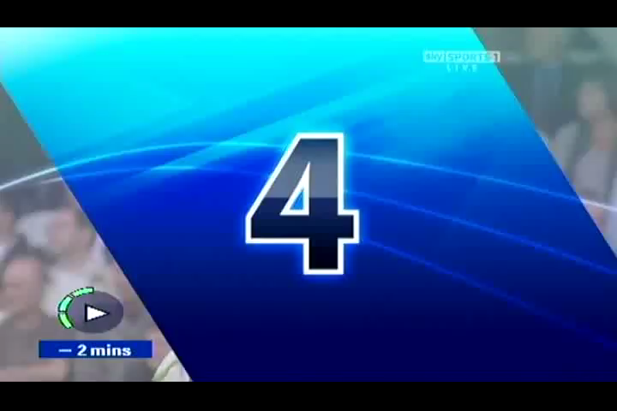

Slide 21
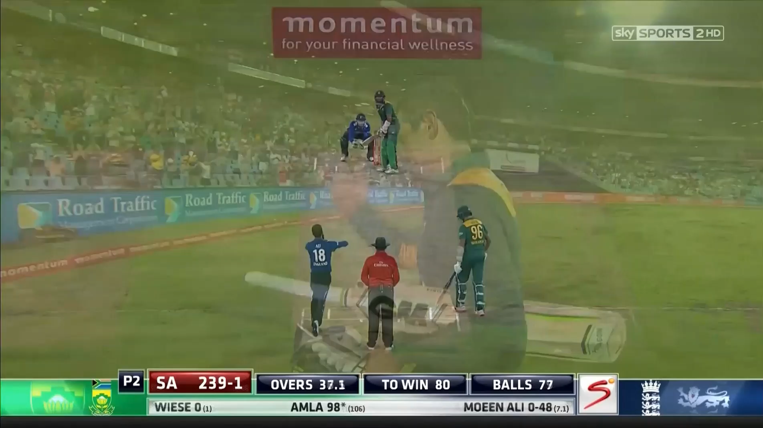

Slide 22
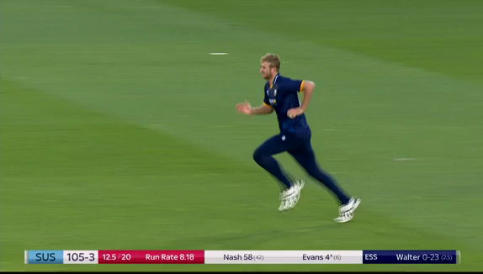

Slide 23
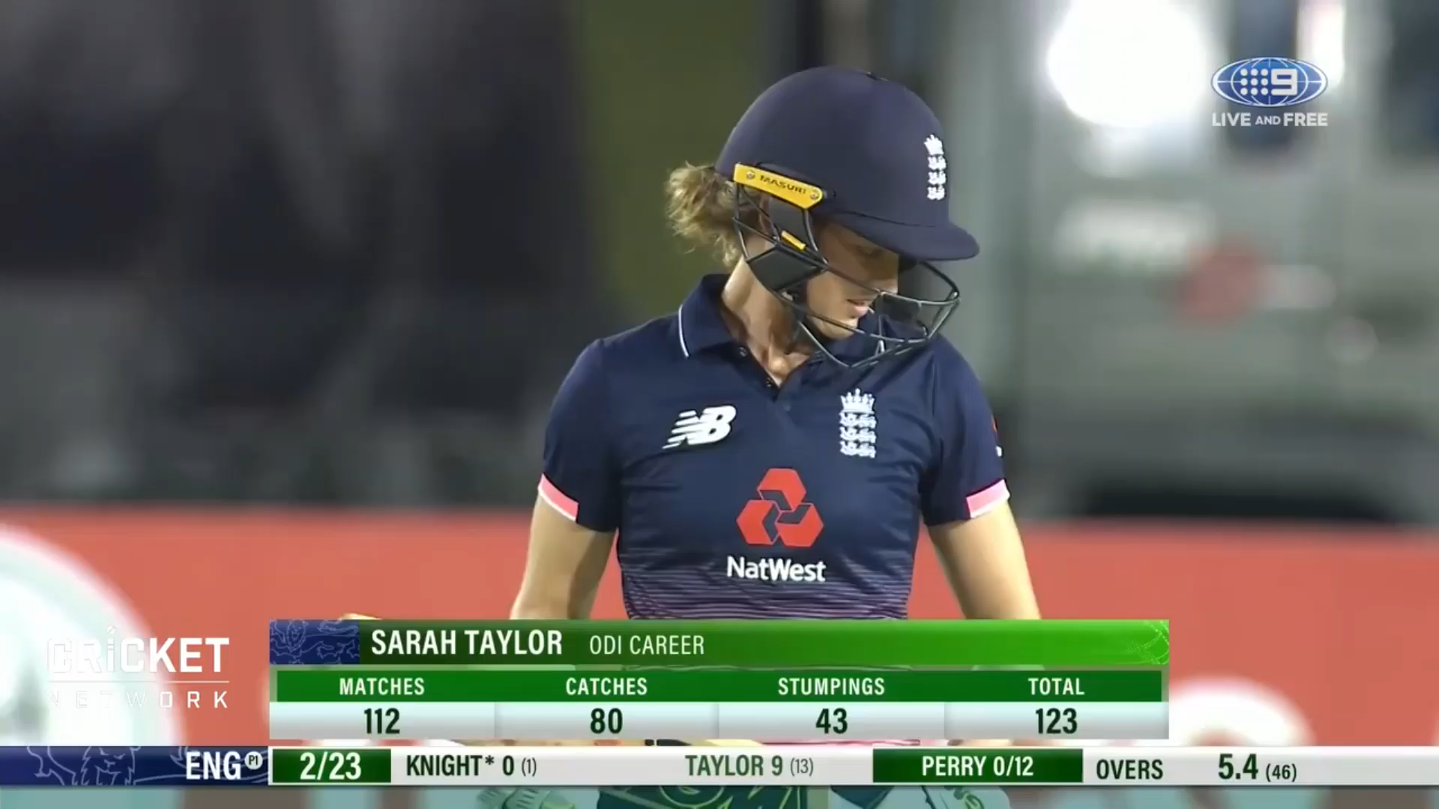

Slide 24
Beamers
Your reactions were probably a range of:
A wince and/or sharp intake of breath
Well yeah, I suppose that’s a No Ball
Barely suppressed laughter!
Could we suggest that a) indicates it was dangerous
and b) and c) that it was not? (as a one off, bearing in mind repetition)
Press your space bar for the next slide

Slide 25
Beamers – Fieldcraft / Problem areas
We will now replay some of those clips again and point out some of the fieldcraft techniques displayed and where disputes sometimes occur
Press your space bar for the next slide

Slide 26
In this instance the striker nearly gets a 4 from the Beamer.
This is irrelevant – it’s still a No ball and warning if considered dangerous
For all video’s click to play
Then press the space bar when video has finished to step on to the next one

Slide 27
In this instance the striker does hit the ball for 4 but it is still a No Ball but probably not a warning
(The clip stop just as the
Umpire starts to signal 4)

Slide 28
Here the bowler apologises straight away – “Sorry, it was an accident Umps”
Again irrelevant and a No ball and warning
(Any moans from bowler
or captain about the warning
the answer is simple:
“I know it was an accident
that’s why he is still bowling”
- See Deliberate Beamers later)

Slide 29
Here watch the bottom right of screen on the real time section.
You will see the striker’s end Umpire signal No Ball to his
colleague
Still a No ball even though well wide of the striker.

Slide 30
..and again here on the second and third replays.
(Although I think you could have called this one yourself!)
What could Striker’s end have done differently?
Click here to reveal answer
Signalled with the arm nearest to his colleague so it was easier for him to see

Slide 31
Here, after the first beamer, Claire Polosak calls No Ball, warns the Bowler and then looks for her captain to tell her as well
After the second beamer
and No Ball call she talks to the bowler, who seems to know what is coming, and then explains to the captain that the bowler is suspended.
All handled very professionally
(Remember this occurred before the Law change regarding dangerous beamers)

Slide 32
Beamers – so what procedure did the umpire follow?
First Dangerous Beamer
Call and Signal No Ball
When the ball is dead:
Repeat signal to scorers
First and final warning to bowler
Inform captain, colleague and batters
Second Dangerous Beamer
Call and Signal No ball
When the ball is dead:
Repeat signal to scorers
Direct Captain to remove bowler from the attack
Inform as before
Report after the match
Please note there is no “Quiet word” after a dangerous beamer
It is a No ball and it is a warning – Zero Tolerance
Press your space bar for the next slide

Slide 33
Umpire actions in respect of Bouncers and Beamers
Although the actions around Bouncers and Beamers are similar remember the two are completely independent of each other.
This means a bowler can have a First & Final Warning for bowling bouncers and a First & Final Warning for bowling beamers
One more of either would mean they were removed from the attack
Press your space bar for the next slide

Slide 34
Beamers – Deliberate Beamer
Fortunately this is a very rare occurrence
If you suspect a deliberate beamer – discuss it with your colleague
(This is a very serious accusation so don’t go there alone)
How would you know?
  Possibly some “previous” between bowler and striker
  In that game – you should, maybe, have picked up on it
  In previous games – you may not have any idea
  A series of events to upset the bowler – boundaries, dropped catches, edges etc.
  Perceived umpiring errors / striker not “walking”
Press your space bar for the next slide

Slide 35
Beamers – Deliberate Beamer
If one (or preferably both of you) are convinced it was a deliberate beamer:
The warning process is dispensed with
Immediately direct the captain to remove the bowler from the attack
Inform the batters
Report the incident after the game
Press your space bar for the next slide

Slide 36
Beamers – alternative regulations
You may have heard that there are various interpretations of “Dangerous Beamers” defined by where the ball passes the striker, i.e. how wide of them and how high.
These are not Laws of Cricket but have been adopted as playing regulations in various Leagues and Competitions throughout the country.
Please consult your own Playing Regulations for guidance on this matter
If there is nothing, then the Laws of Cricket apply as described in the body of this presentation
Press your space bar for the next slide

Slide 37
Bouncers are covered in a separate presentation
Thank you for watching
For further information on all aspect of umpiring please
contact your County Association of Cricket Officials
Produced by:
Ian Royle, Regional Education Officer
Edited by:
John Golding, Regional Development Officer

